Slide 1
Bev’s Bakery
Web Design RFP
Adrian Grimm
14 March 2020 • WDD229

Slide 2
URL and Hosting
BevsBakery.com
Available for purchase for $8.88/yr from namecheap.com.
A search returns a Facebook page but no other online presence.
Simple, effective URL is easy to remember and highlights the name of the business.
Hosted on HostGator
Monthly cost of $10.95
Guaranteed 99.9% Uptime
Unmetered storage and bandwidth
Unlimited email and FTP accounts
Free SSL Certification
Secure databases with password protection

Slide 3

Color Palette
I chose this palette for bright and vibrant colors and stark contrast between elements.
Blue is the most-preferred color and represents security and trust in a brand. This shade was selected for whimsical vibrance.
Green is the second most-preferred color, easily processed by the eye, and represents tranquility and health.
Red shows passion and urgency and is often used to stimulate the hunger impulse to promote the purchase of food, in this case baked goods.

Slide 4

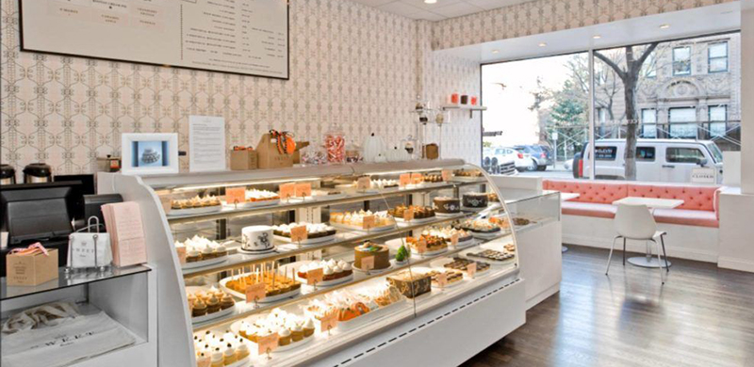
Browser
https://www.bevsbakery.com
Welcome to Bev’s Bakery!

Slide 5

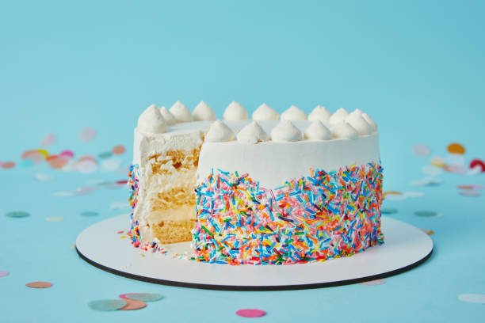

Browser
https://www.bevsbakery.com

